Slide 1

SPARQL-based Linking of Knowledge Graphs
Wenqi Jiang(21A272)
wenqi.jiang@alumnos.upm.es
Raul Garcia Castro Inteligencia Artificial ETSI Informáticos Universidad Politécnica de Madrid
Andrea Cimmino Arriaga Sistemas Informáticos ETSI Sistemas Informáticos Universidad Politécnica de Madrid
Notes:
Good morning, everyone!
My name is Wenqi Jiang. I am a master student in data science at UPM.
Today I want to share my master's final project—LOOM-LD, which is a SPARQL-based Linking of Knowledge Graphs.
Firstly, I would like to express my gratitude to my tutors, Raul and Andrea, without whom I would not have been able to accomplish this project. Thank you for your persistent help over the last several months.

Slide 2

Abstract
This TFM focuses on the specification and development of a link discovery proposal based on standard SPARQL.
RDF linking is based on one or more link rules that specify the conditions that two RDF resources can be considered the same, such as text similarity or geographical position.
This TFM featured a SPARQL-based application to link knowledge graphs using Apache Jena as the SPARQL engine.
It evaluated the results with several data sets from the OAEI competition in 2021 and achieved excellent results.
Keywords— RDF, SPARQL, Linking algorithm, Apache Jena, OAEI
Notes:
So, what exactly is my project, and then what can it do?
This project focuses on the specification and development of a link discovery proposal based on standard SPARQL.
RDF linking is based on one or more link rules that specify the conditions that two RDF resources can be considered the same, such as text similarity or geographical position.
This project featured a SPARQL-based application to link knowledge graphs using Apache Jena as the SPARQL engine.
It evaluated the results with several data sets from the OAEI competition in 2021 and achieved excellent results.

Slide 3
Contents
Introduction
State of the Art
LOOM-LD
Evaluation and Conclusion
Future Work
Notes:
This slide shows what I'm going to share today, and I will explain my project in the following five sections: introduction, state of the art, LOOM-LD, evaluation, and conclusion, and last but not least, the future work.

Slide 4

Introduction
Notes:
This chapter is the introduction to this work and focuses on the current situation and the problems encountered[ɪn'kaʊntəd]. It has two parts, as follows: Section 1 is the context of this research work; Section 2 presents the possible issues in linking these ontologies nowadays. This chapter presents a comprehensive grasp of the broad background of this project, why to link ontologies, and how to achieve the goal.

Slide 5

Research Context
In the age of big data, vast volumes of heterogeneous data are created daily, but machines can’t read and analyze them efficiently.
The Web of Data idea aims to make Internet data machine-readable, which helps store, maintain, and distribute knowledge. So, computers can utilize it without human parsing.
The Resource Description Framework (RDF) is the Web of Data’s standard data model format, which can be used to analyze and link diverse ontologies.
This project aims to link redundant and duplicate RDFs to make the Web of Data more efficient and concise.
Notes:
In the big data age, lots of heterogeneous[ˌhɛtərəˈdʒiniəs] data are created daily, but machines can’t read and analyze them efficiently. The Web of Data idea aims to make Internet data machine-readable, which helps store, maintain, and distribute knowledge. So, computers can utilize it without human parsing. The Resource Description Framework (RDF) is the Web of Data’s standard data model format, which can be used to analyze and link diverse ontologies. This project aims to link redundant and duplicate RDFs to make the Web of Data more efficient and concise[kənˈsaɪs].

Slide 6
The Linking Task
The linking task consists of two parts: generating link rules and implementing them efficiently.
The contents of generating link rules include choosing transformation and similarity metrics, which are used in determining whether two resources should be linked based on their literal data attributes.
It must rely on Instance Matching (IM) and Link Discovery technologies to do so.
A few engines, such as Limes and Silk, have achieved this goal. However, most of them rely on their own link rules languages, and they are not based on a common standard and thus result in a steep learning curve.
Notes:
The linking task consists of two parts: generating link rules and implementing them efficiently. The contents of generating link rules include choosing transformation and similarity metrics, which are used in determining whether two resources should be linked based on their literal data attributes. It must rely on Instance Matching (IM) and Link Discovery technologies to do so. A few engines, such as Limes and Silk, have achieved this goal. However, most of them rely on their link rules languages, and they are not based on a common standard and thus result in a steep learning curve.

Slide 7
The Linking Task
Furthermore, a Cartesian product of the resources of two data sets will be performed in some situations during the comparison of the data under the specific link rules. Thus, RDF linking is a computationally intensive job because it requires comparing all resources from one dataset with all resources from another.
This project created a more general way to link ontologies based on SPARQL by implementing functions in Apache Jena. So, practitioners don’t need to learn another language to link ontologies. Using the SPARQL query is enough.
Notes:
Furthermore, a Cartesian[kɑrˈtiziən] product of the resources of two data sets will be performed in some situations during the comparison of the data under the specific link rules. Thus, RDF linking is a computationally intensive job because it requires comparing all resources from one dataset with all resources from another.
This project created a more general way to link ontologies based on SPARQL by implementing functions in Apache Jena. So, practitioners don’t need to learn another language to link ontologies. Using the SPARQL query is enough.

Slide 8
State of the Art
Notes:
The focus of this chapter is to present modern technologies that are relevant to the mission.
Section 1 presents an RDF example on the Web of Data.
Section 2 presents a SPARQL query example for this RDF.
The most important section is Section 3, Apache Jena, which introduces a query engine that supports this SPARQL query and how to write a custom function in Jena ARQ. This chapter will provide a clear image of how information is represented in the real world and how to execute simple operations on these ontologies, and it will provide the basis for this project development in the next chapter.

Slide 9
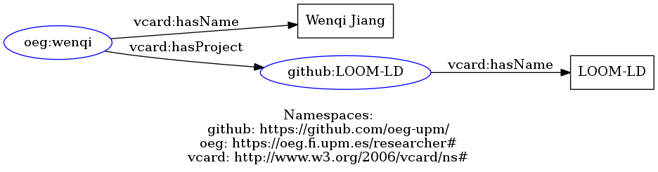
RDF
A triple example:
subject => “wenqi”, predicate => “hasName”, object => “Wenqi Jiang”.
An URL / IRI example: https://github.com/oeg-upm/loom-ld
Turtle format:
@prefix github: <https://github.com/oeg-upm/> .
@prefix oeg: <https://oeg.fi.upm.es/researcher#> .
@prefix vcard: <http://www.w3.org/2006/vcard/ns#> .
oeg:wenqi vcard:hasName "Wenqi Jiang" ;
vcard:hasProject github:LOOM-LD .
github:LOOM-LD vcard:hasName "LOOM-LD" .
Notes:
The Resource Description Framework (RDF) is a standard data model for metadata. It has come to be used as a general method for the description and exchange of graph data.
An RDF is a directed graph composed of triple statements. An RDF graph statement is represented by: 1) a node for the subject; 2) an arc that goes from a subject to an object for the predicate['predɪkət]; and 3) a node for the object.
Each of the three parts of the statement can be identified by a URI. An object can also be a literal value.
Like the example shows here, “Wenqi hasName Wenqi Jiang”, where wenqi is a subject and hasName is the predicate, “Wenqi Jiang” is the object with a literal value.
RDF provides many different data serialization formats, like Turtle shows here, which is currently the most widely used notation.
This simple, flexible data model has a lot of expressive power to represent complex situations, relationships.

Slide 10
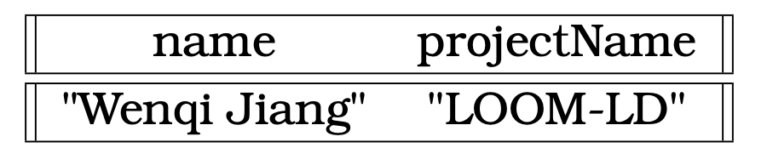
SPARQL
Getting the names of all researchers and the GitHub projects they are working on.
PREFIX oeg: <https://oeg.fi.upm.es/researcher#>
PREFIX github: <https://github.com/oeg-upm/>
PREFIX vcard: <http://www.w3.org/2006/vcard/ns#>
SELECT ?name ?projectName WHERE {
?researcher vcard:hasProject ?project;
vcard:hasName ?name.
?project vcard:hasName ?projectName.
}
Notes:
RDF is a directed, labeled graph data format for representing information in the Web. SPARQL is the query language for RDF.
SPARQL can be used to express queries across diverse data sources. The results of SPARQL queries can be results sets or RDF graphs. This is an example of a SPARQL query, which aims to get the names of all researchers and the GitHub projects they are working on.

Slide 11
SPARQL
SELECT ?name ?projectName WHERE {
?researcher vcard:hasProject ?project;
vcard:hasName ?name.
?project vcard:hasName ?projectName.
}
A SELECT clause, which says how the results will be given back to the user. SPARQL return data in different ways, the table result with SELECT, the graph result with DESCRIBE or CONSTRUCT, or the boolean answer with ASK.
A WHERE clause is constructed from a graph pattern. Informally, this sentence is represented by a pattern corresponding to an RDF network. In addition, more complicated expressions (patterns) that are created using advanced operators are also permitted, like filter etc.
A FROM clause, which specifies the sources or endpoints to be queried.
Notes:
A SPARQL is generally divided into three parts.
A SELECT clause[klɔz], which says how the results will be given back to the user. SPARQL return data in different ways, the table result with SELECT, the graph result with DESCRIBE or CONSTRUCT, or the boolean answer with ASK. A WHERE clause is constructed from a graph pattern. Informally, this sentence is represented by a pattern corresponding to an RDF network. In addition, more complicated expressions (patterns) that are created using advanced operators are also permitted, like filter etc. A FROM clause, which specifies the sources or endpoints to be queried.

Slide 12
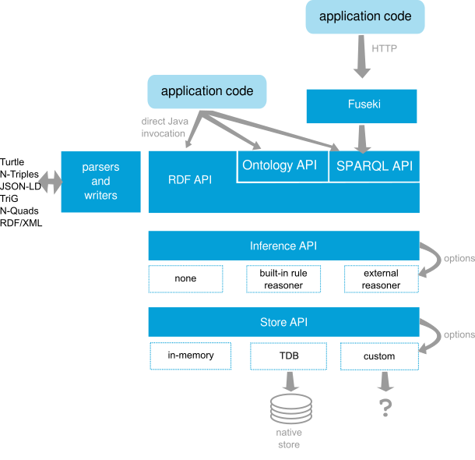
Jena Architecture
The RDF API, which is used to create and manipulate RDF graphs.
The Ontology API, which provides a consistent programming interface for ontology application development, independent of which ontology language which using in the programs.
The SPARQL API, which is a query engine for Jena that supports the SPARQL RDF Query language.
Notes:
Apache Jena is a free and open-source Java framework for building semantic web and linked data applications. This is a diagram of Jena's architecture. Here we focus on the three most core parts.
1. The RDF API, which is used to create and manipulate RDF graphs, 2. The Ontology API provides a consistent programming interface for ontology application development, independent of which ontology language is used in the programs. 3. The SPARQL API, which is a query engine for Jena that supports the SPARQL Query language.

Slide 13
Jena ARQ Usage
Model model = ModelFactory.createDefaultModel()
.read(IOUtils.toInputStream(RDF, "UTF-8"), null, "TURTLE");
Query query = QueryFactory.create(SPARQL);
try (QueryExecution qexec = QueryExecutionFactory.create(query, model)) {
ResultSet results = qexec.execSelect();
ResultSetFormatter.out(System.out, results, query);
}
The ModelFactory.createDefaultModel() gets a new model, and it can load the RDF data from a String.
The Model is a collection of statements.
The Query a class that represents the application query. It is a container for all the details of the query. Objects of the class Query are normally created by calling one of the methods of QueryFactory which provides access to the various parsers.
The ResultSet is an iterator, which contains the same query result in the previous slide.
The ResultSetFormatter is a result set formatter, which can print the result in console, or turn it into a JSON, text, or as plain XML.
Notes:
This slide focuses on how to use Apache Jena to run SPARQL queries on RDFs, Jena ARQ is the SPARQL engine,
The ModelFactory.createDefaultModel() gets a new model, and it can load the RDF data from a String. The Model is a collection of statements, it is the RDFs we loaded. The Query a class that represents the application query. It is a container for all the details of the query. Objects of the class Query are normally created by calling one of the methods of QueryFactory which provides access to the various parsers. The ResultSet is an iterator, which contains the same query result in the previous slide. The ResultSetFormatter is a result set formatter, which can print the result in console, or turn it into a JSON, text, or as plain XML.

Slide 14
Jena ARQ Custom Function
1. Writing a SPARQL value function
public static class CustomFunction extends FunctionBase2 {
Cosine cosine = new Cosine();
@Override
public NodeValue exec(NodeValue v1, NodeValue v2) {
return NodeValue.makeDouble(cosine.similarity(v1.asString(), v2.asString()));
}
}
2. Registering this function
FunctionRegistry ref = FunctionRegistry.get();
ref.put("http://oeg.upm.es/loom-ld/functions/linking#", CustomFunction.class);
Notes:
Next is the core part of this project, how to use the Jena ARQ custom algorithm to link graphs.
1. Writing a SPARQL value function, we have two parameters and get the similarity of these two fields.
2. Registering this function, there we can use custom URLs to define our functions names.

Slide 15
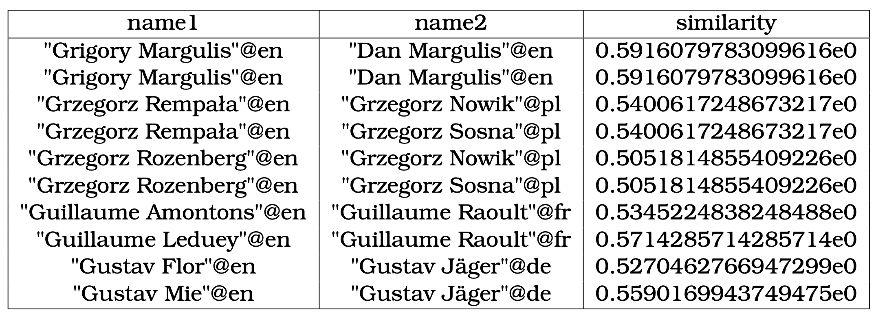
Jena ARQ Custom Function
SELECT ?name1 ?name2 ?similarity WHERE {
SERVICE <http://live.dbpedia.org/sparql?timeout=300000> {
?scientist1 rdf:type dbo:Scientist;
foaf:name ?name1.
}
SERVICE <https://query.wikidata.org/sparql?timeout=300000> {
?scientist2 wdt:P106 wd:Q901;
wdt:P1559 ?name2.
}
BIND(<http://oeg.upm.es/loom-ld/functions/linking#>(?name1, ?name2) AS ?similarity)
FILTER(?similarity >= "0.5"^^xsd:decimal)
}
LIMIT 10
Notes:
This is an example of a simple SPARQL query where we link two scientists from different online databases, Wikidata and DBpedia, based on their names, with a similarity threshold of 50%.

Slide 16
LOOM-LD
Notes:
After giving a general background, this section will dive into the implementation details of the project, LOOM-LD. This chapter focuses on two types of linking algorithms: one based on text similarity, and one based on geometric relationships. So, the structure of this chapter is straightforward: 1. describes the text similarity linking discovery algorithms. 2. describes the geometry linking discovery algorithms.

Slide 17
Text Linking
The implementation of the text similarity algorithms is directly based on the open-source project:
rrice/java-string-similarity
Character-based Similarity
Levenshtein distance (also known as edit distance)
Longest common subsequence
Jaro-Winkler distance
Gestalt pattern matching
Token-based Similarity
Jaccard similarity
Cosine similarity
Notes:
The most common use scenario for a graph linker is to link similar text content. For example, if two resources have the same title, they are likely to be the same resource. String-based similarity is the oldest, simplest, and most common measurement approach for text linking. Two main types of string similarity algorithms are character-based similarity functions and token-based similarity.
The implementation of the text similarity algorithms is directly based on the open-source project: rrice/java-string-similarity
Here I compare six common text similarity algorithms.

Slide 18
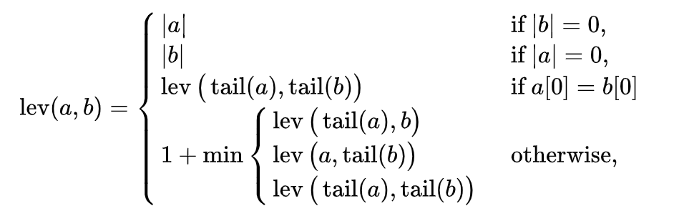
Character-based Similarity
Levenshtein distance
The Levenshtein distance between two words is the minimum number of single-character edits (insertions, deletions or substitutions) required to change one word into the other.
Notes:
Character-based Similarity is also called sequence-based or edit distance measurement, which is a way of quantifying how dissimilar two strings are by counting the minimum number of operations required to transform one string into the other. The operations include insertion, deletion, and substitution.
The Levenshtein Distance allows deletion, insertion, and substitution. The Longest Common Subsequence (LCS) distance allows only insertion and deletion, not substitution.
The Jaro distance allows only transposition[ˌtrænspəˈzɪʃən].

Slide 19
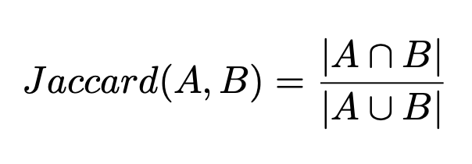
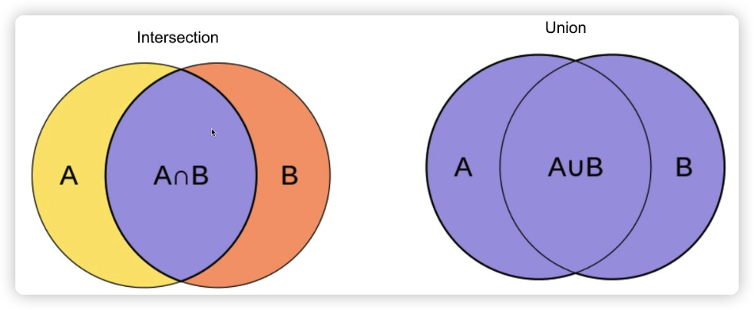
Token-based Similarity
Jaccard similarity
Jaccard similarity is computed as the number of shared terms over the union of all the terms in both strings.
Notes:
The term-based similarity is also called token-based because it treats each string as a set of tokens.
The Jaccard[杰卡德] coefficient [ˌkoʊɪˈfɪʃnt] measures similarity between finite [ˈfaɪˌnaɪt] sample sets and is defined as the size of the intersection divided by the size of the union of the sample sets.

Slide 20
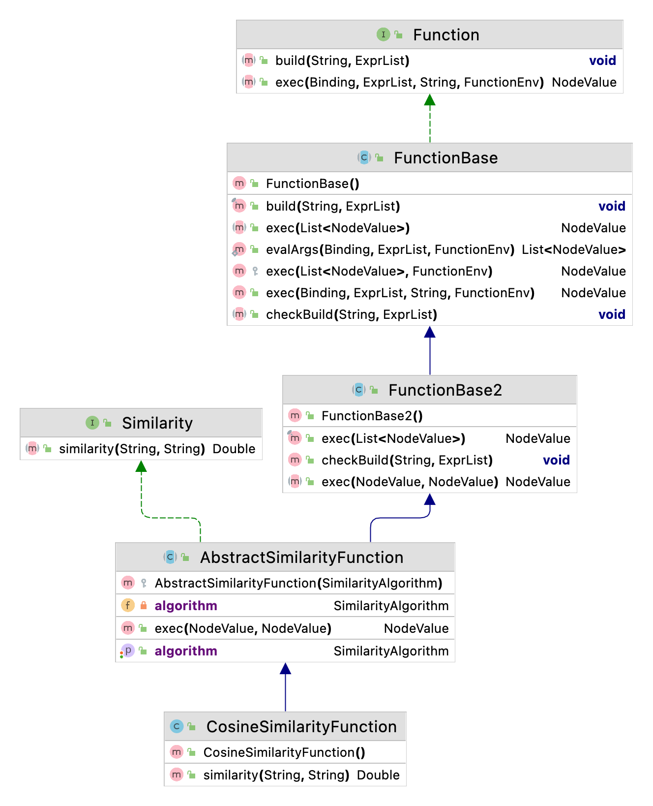
Notes:
First, take a brief look at the architecture of the text linking, as shown in this picture. Interfaces specify what a class must do rather than how to do it, which is the blueprint of the class.
So, I implemented a custom Similarity interface to calculate text similarity, and it can significantly reduce code redundancy.
Then I created an abstract class, AbstractSimilarityFunction, which does some common preparatory [prɪˈpærətɔri] work, like extending FunctionBase2 and implementing Similarity interface.
The next step is to implement the concrete[ˈkɑŋkrit] classes, which are the actual similarity functions. For instance, the CosineSimilarityFunction is shown here.
Once the algorithms are implemented, it is necessary to be registered.

Slide 21
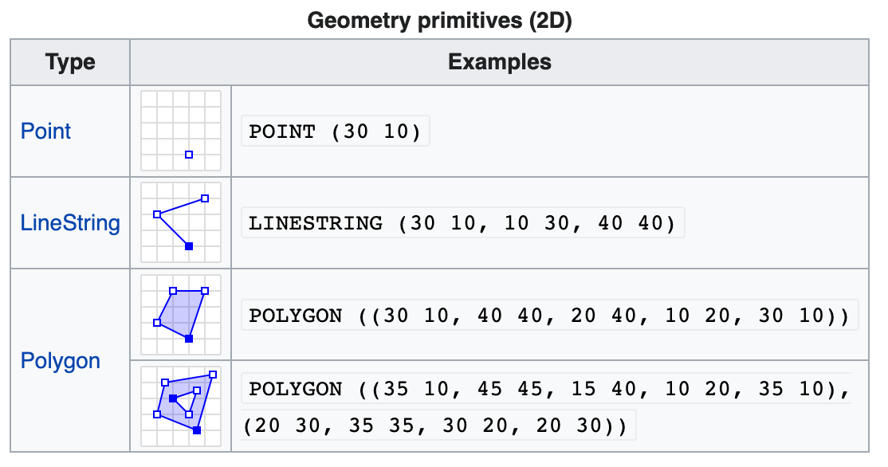
Geometry Linking
Well-know Text(WKT)
Well-known text (WKT) is a text markup language for representing vector geometry objects.
Notes:
There is another type of linking in the graph linker usage scenarios besides linking based on text similarity, which is to link two regions based on their spatial relationship. It is called geometry linking. Before implementing the set of linking algorithms, two basic concepts must be clarified.
The first one is how to represent the spatial data?
The second one is: what are the relationships between these spatial data sets?
Well-known text (WKT) is a text markup language for representing vector geometry objects.

Slide 22
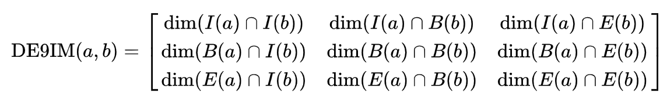
Geometry Linking
The Dimensionally Extended 9-Intersection Model (DE-9IM)
The DE-9IM model is based on a 3×3 intersection matrix with the form:
where dim is the dimension of the intersection (∩) of the interior (I), boundary (B), and exterior (E) of geometries a and b.
Notes:
[də'menʃənəlɪ]
The Dimensionally Extended 9-Intersection Model (DE-9IM) is a topological [tɒpə'lɒdʒɪkəl] model and a standard used to describe the spatial relations of two regions in geometry.
The DE-9IM model is based on a 3×3 intersection matrix with the form:
where result is the dimension of the intersection (∩) of the interior [ɪnˈtɪriə(r)] (I), boundary (B), and exterior [ɪkˈstɪriər] (E) of geometries a and b.

Slide 23
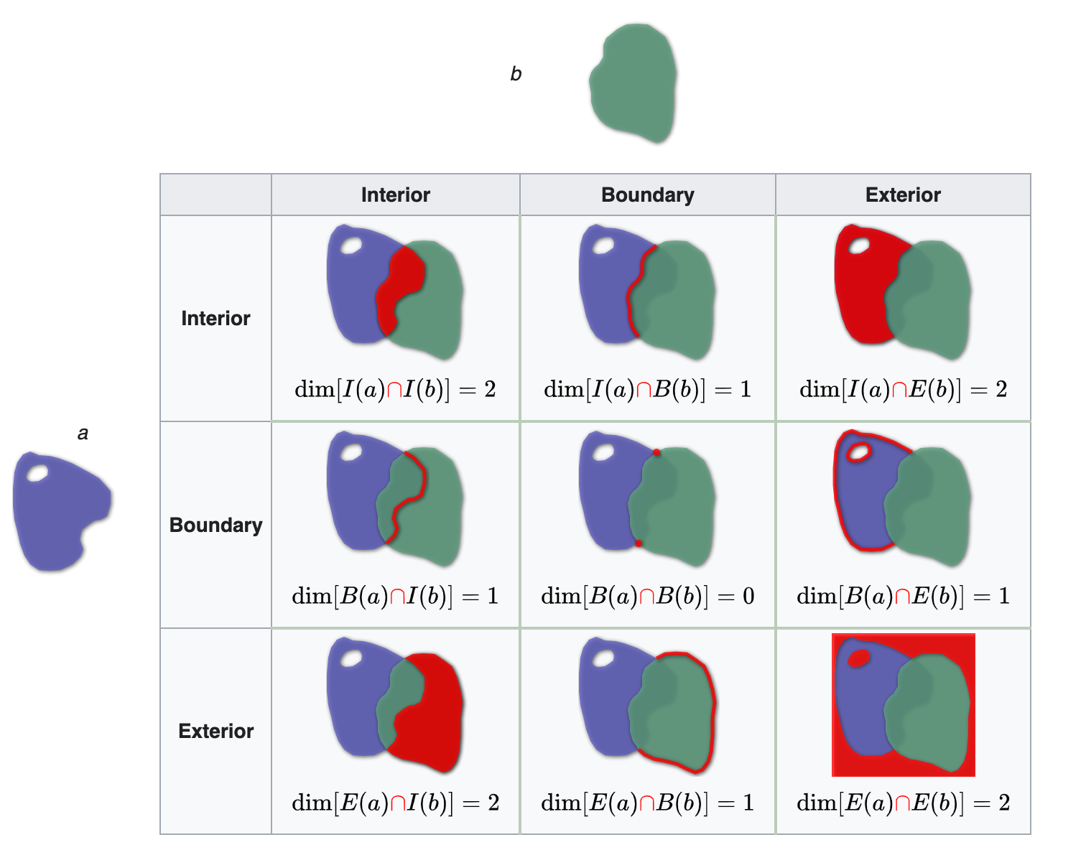
Geometry Linking
The Dimensionally Extended 9-Intersection Model (DE-9IM)
Library:
JTS Topology Suite
Relations:
contains
coveredBy
covers
disjoint
equals
intersects
overlaps
touches
crosses
within
Notes:
The library I used is JTS topology[tə'pɑlədʒɪ] suite[swit]
The result of the function looks like this picture, and we will determine these ten relationships as follow.

Slide 24
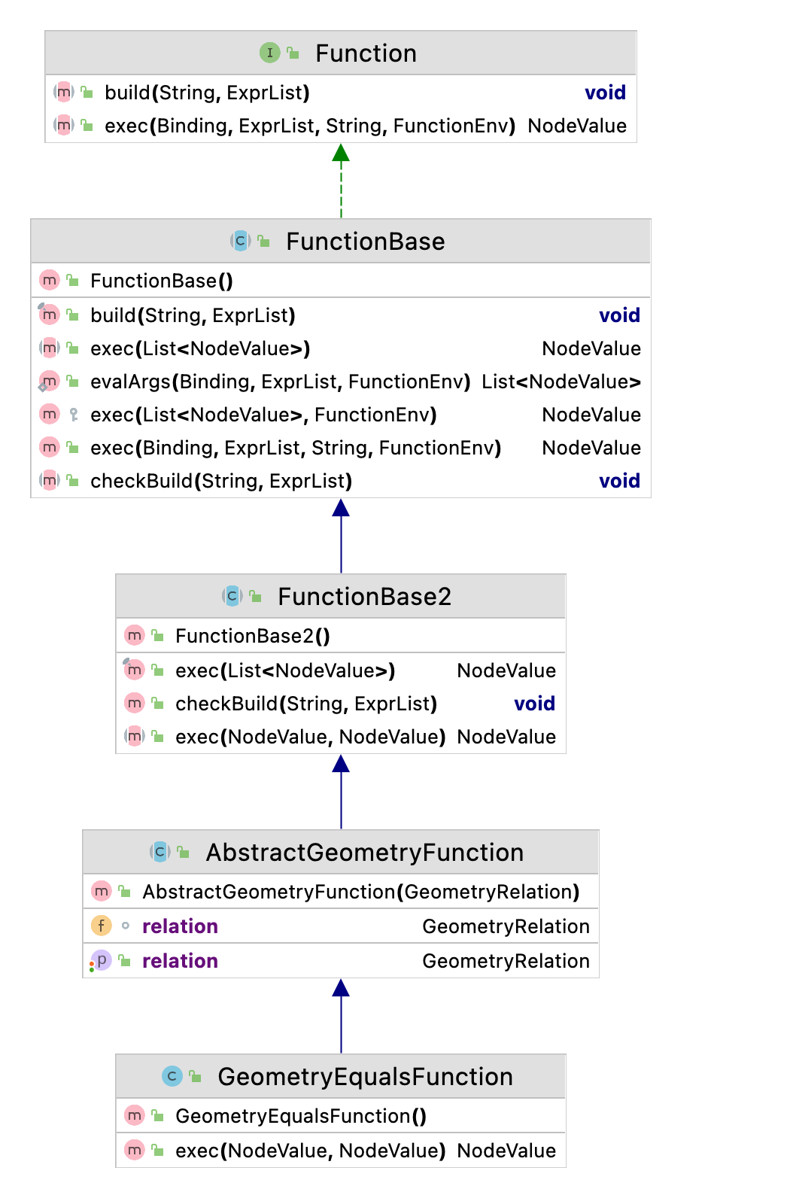
Notes:
Similarly, it needs an abstract class to do some preparatory work that can initialize the WKTReader to load the spatial data.
And then the project specified the implementation of the function. It just needs to use WKTReader to load the spatial data and use the relationship function in it.

Slide 25
Evaluation and Conclusion
Notes:
This chapter focuses on applying the algorithms to the dataset of the Ontology Alignment [əˈlaɪnmənt] Evaluation Initiative [ɪˈnɪʃətɪv] (OAEI). It is organized as follows: Section 1 presents the OAEI contest and the experiment metrics. Section 2 presents the experiment datasets and each result.

Slide 26
Ontology Alignment Evaluation Initiative (OAEI)
The increasing number of methods available for schema or ontology matching mandates consensus for evaluation of these methods. The Ontology Alignment Evaluation Initiative is a coordinated international initiative to forge this consensus.
The goals of the Ontology Alignment Evaluation Initiative are:
assessing strengths and weaknesses of alignment and matching systems;
comparing performance of techniques;
increasing communication among algorithm developers;
improving evaluation techniques;
most of all, helping improve the work on ontology alignment and matching.
Through the controlled experimental evaluation of the technique's performance.
Notes:
The increasing number of methods available for schema or ontology matching mandates [ˈmænˌdet] consensus [kənˈsɛnsəs] for evaluation of these methods. The Ontology Alignment Evaluation Initiative is a coordinated international initiative to forge this consensus.
The goals of the Ontology Alignment Evaluation Initiative are:
assessing strengths and weaknesses of alignment and matching systems;
comparing performance of techniques;
increasing communication among algorithm developers;
improving evaluation techniques;
most of all, helping improve the work on ontology alignment and matching.
Through the controlled experimental evaluation of the technique's performances.

Slide 27
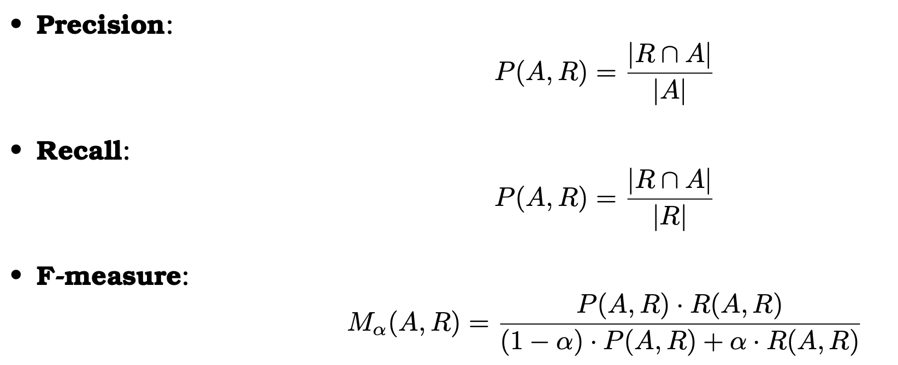
Evaluation Metrics
1. Competency benchmarks:
Precision and recall are currently the most well-understood evaluation measures.
One possibility consists of proposing a reference alignment (R) that is the one that the participants must find (a gold standard).
The result from the evaluated alignment algorithm (A) can then be compared to that reference alignment.
2. Performance benchmarks: Speed and Memory

Slide 28
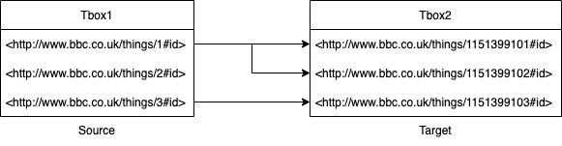
SPIMBENCH
The goal of the SPIMBENCH task is to determine when two instances describe the same creative work. It needs to match instances in the source dataset (Tbox1) against the instances of the target dataset (Tbox2). An instance in the source (Tbox1) dataset can have none or one matching counterparts in the target dataset (Tbox2).
There are 3105 records in the source dataset (Tbox1) and 2802 records in the target dataset (Tbox2).

Slide 29
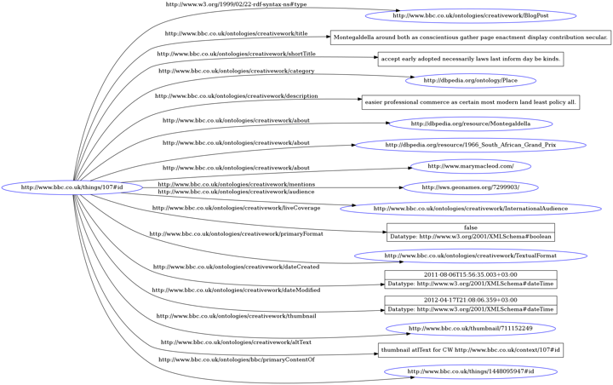

Slide 30
SPARQL
CONSTRUCT { ?thing1 owl:sameAs ?thing2. }
WHERE {
?thing1 seals:isLocatedAt "tbox1.nt".
OPTIONAL { ?thing1 cwork:title ?title1. }
OPTIONAL { ?thing1 cwork:shortTitle ?shortTitle1. }
OPTIONAL { ?thing1 cwork:description ?description1. }
?thing2 seals:isLocatedAt "tbox2.nt".
OPTIONAL { ?thing2 cwork:title ?title2. }
OPTIONAL { ?thing2 cwork:shortTitle ?shortTitle2. }
OPTIONAL { ?thing2 cwork:description ?description2. }
BIND(loom:lcs(?title1, ?title2) AS ?titleGrade)
BIND(loom:lcs(?shortTitle1, ?shortTitle2) AS ?shortTitleGrade)
BIND(loom:lcs(?description1, ?description2) AS ?descriptionGrade)
FILTER(?thing1 != ?thing2)
FILTER(((?titleGrade >= "0.7"^^xsd:decimal) || (?shortTitleGrade >= "0.7"^^xsd:decimal)) || (?descriptionGrade >= "0.7"^^xsd:decimal))
}

Slide 31
Result
Algorithm | Threshold | Golden Size | Result Size | Precision | Recall | F1 | Milliseconds
Cosine | 0.6 | 225 | 225 | 0.898 | 0.898 | 0.898 | 15,733
Jaccard | 0.3 | 225 | 230 | 0.896 | 0.916 | 0.905 | 16,767
Jaro-Winkler | 0.8 | 225 | 232 | 0.828 | 0.853 | 0.84 | 15,407
Levenshtein | 0.5 | 225 | 237 | 0.899 | 0.947 | 0.922 | 24,110
LCS | 0.6 | 225 | 235 | 0.898 | 0.938 | 0.917 | 15,152
Ratcliff-Obershelp | 0.6 | 225 | 236 | 0.898 | 0.942 | 0.92 | 130,843
Notes:
Using the levenshtein algorithm with 50% as the threshold, the evaluation got the best precision of 0.899 and the best F1 score of 0.922. As for the recall rate, almost all the algorithms used achieved the same highest value, 0.947. So, it turned out that the levenshtein algorithm is the best algorithm for the task of string similarity. As for the performance benchmark, the calculation time, LCS just needed around 15 seconds, and achieved over 0.9 on both recall and f1 score, which is significantly faster than other algorithms.

Slide 32
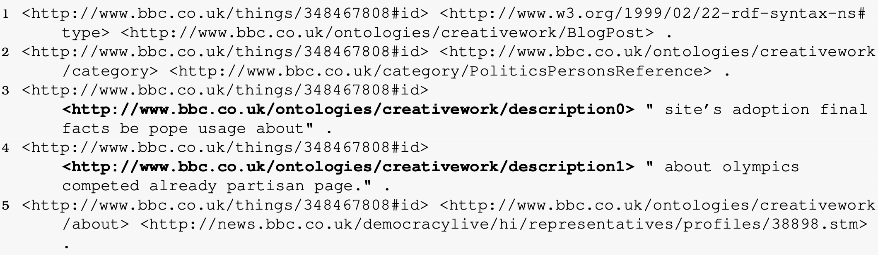
Problems
The filed names are not matched, like description0, description1, etc.
2. There are not any text fields (datatype: xsd:string) can be used to match.
Notes:
It should be noted that the recall rate of some results got the same value 0.947. It is very likely that some golden matching results cannot be matched by calculating their text similarity, so after carefully checked the results that do not match, and found the following several situations.

Slide 33
Spatial Data Matching
The spatial datasets used here are groups by two parts, which are TomTom and Spaten.
TomTom has a Synthetic Trace Generator that makes it easy to create any amount of data from statistics about vehicle traffic. More specifically, it makes traces, which are a list of (longitude, latitude) pairs that one device (phone, car, etc.) records over the course of one day.
Spaten is an open-source, programmable, spatio-temporal and textual dataset generator that can make a lot of data based on how users act in the real world. Using the Google Maps API, Spaten takes GPS tracks from real routes and combines them with real POIs and relevant user comments from TripAdvisor. Spaten creates GB-sized datasets with millions of check-ins and GPS tracks available to the public.
This round of the challenge evaluated the ability to recognize DE-9IM topological relations, which are the following: Equals, Disjoint, Touches, Contains/Within, Covers/CoveredBy, Intersects, Crosses, Overlaps. All traces are represented in WKT format. Each relation will be assigned a unique pair of source and target datasets. This task is used to evaluate the performance of systems that deal with topological connections presented in the cutting-edge DE-9IM model, where all topological relations between trajectories are in two-dimensional space.

Slide 34
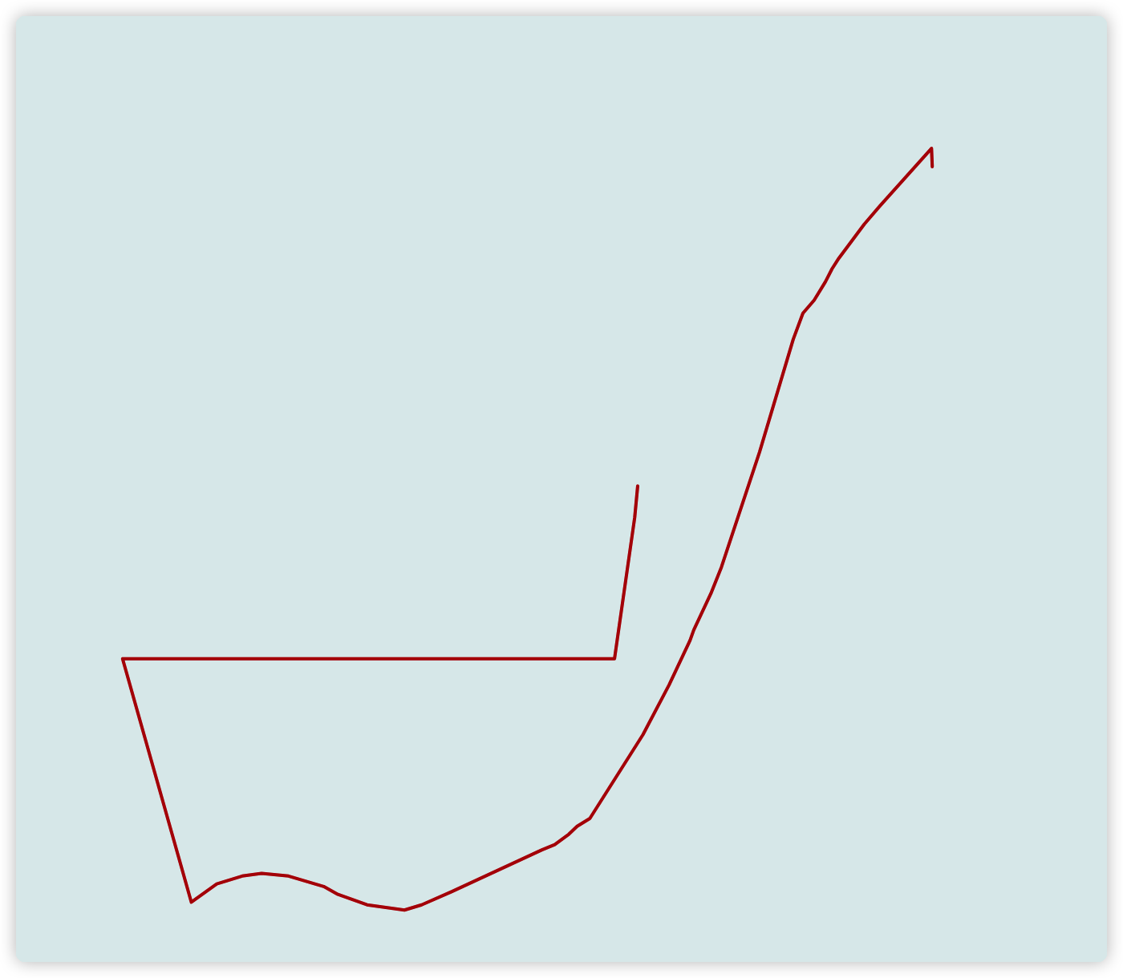
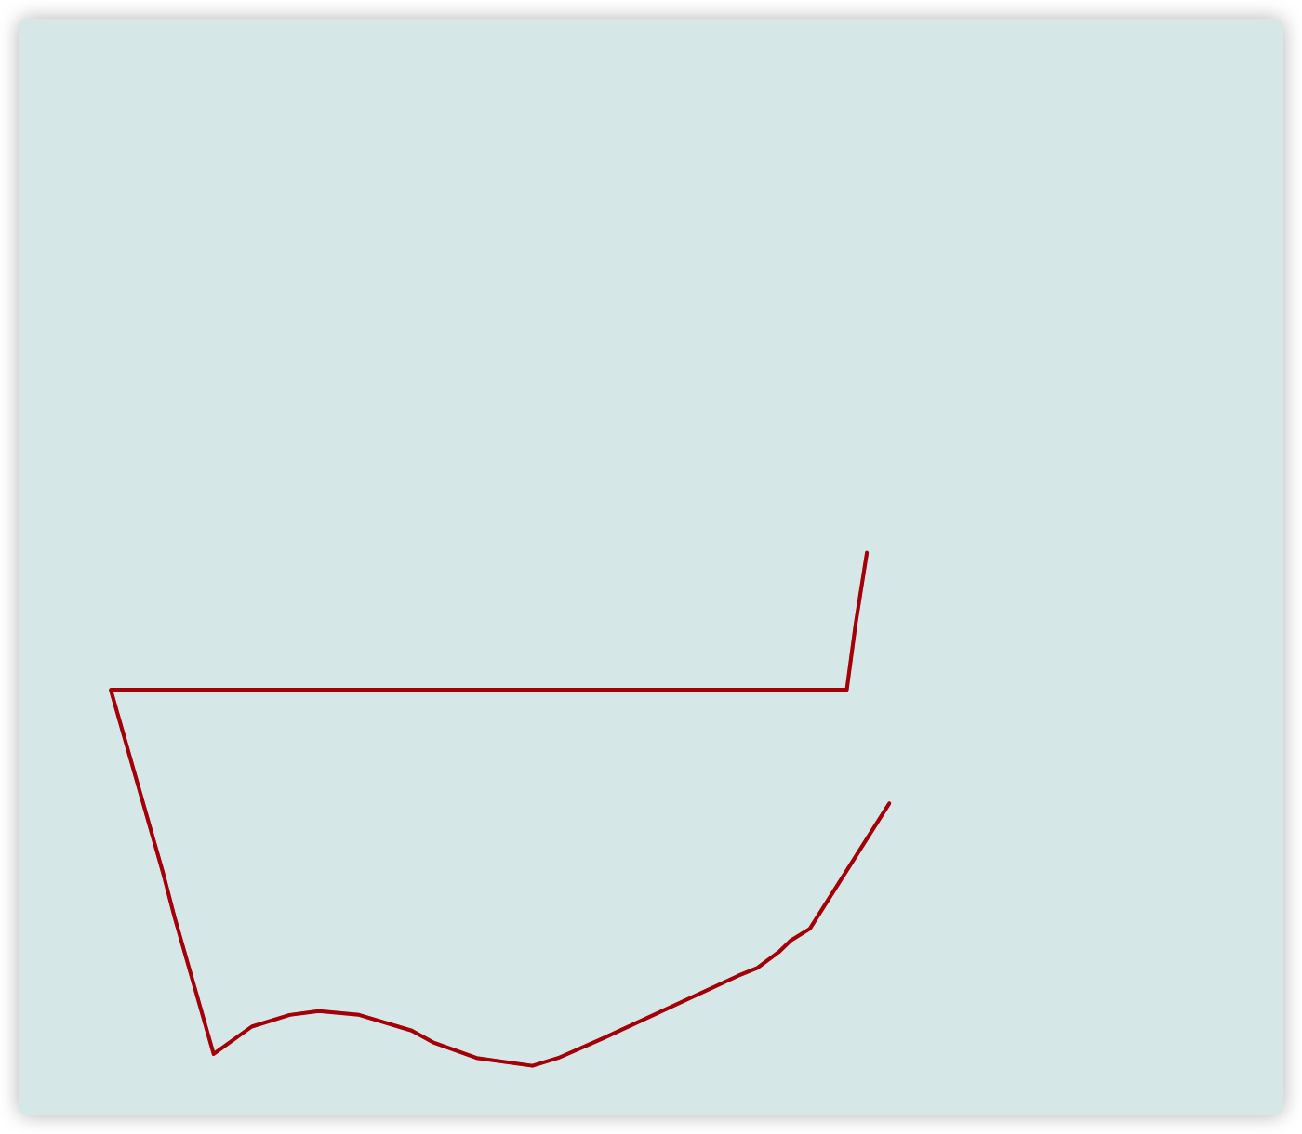
An Example of Covers

Slide 35
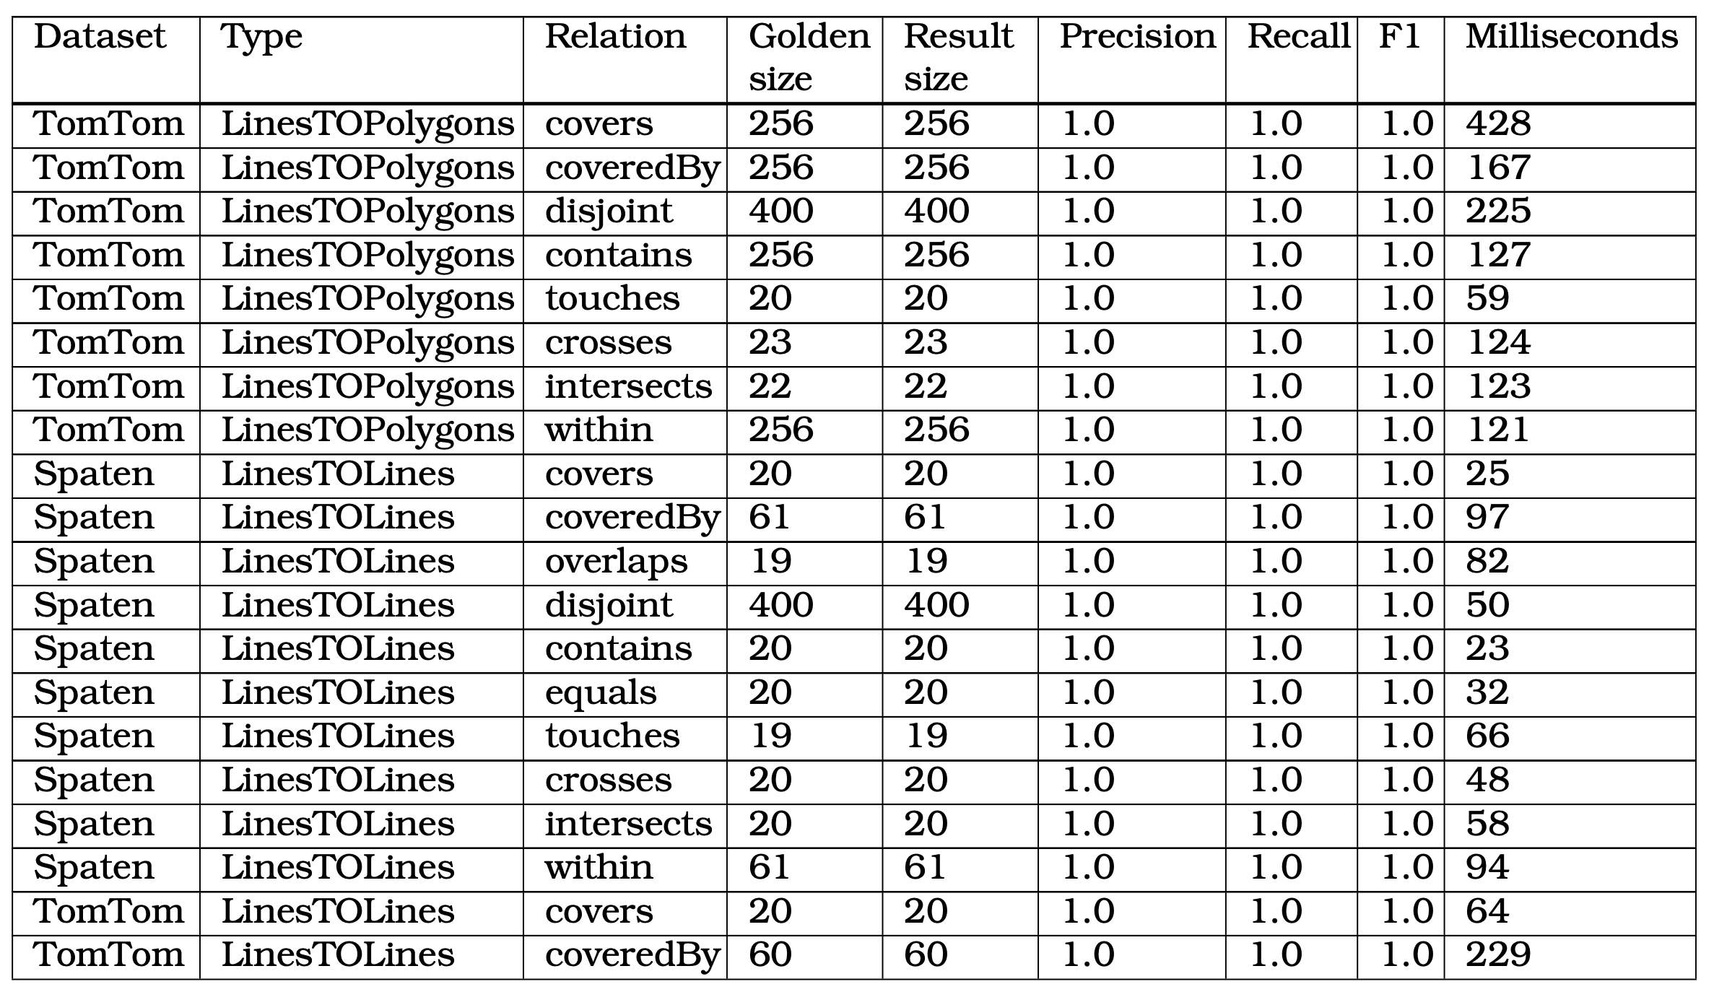
Result
Notes:
After checking the results, it is obvious that the spatial data were perfectly mapped to each other, and the running time was also fast. This shows that the algorithm performs very well when faced with data matching tasks with complete data formats.

Slide 36
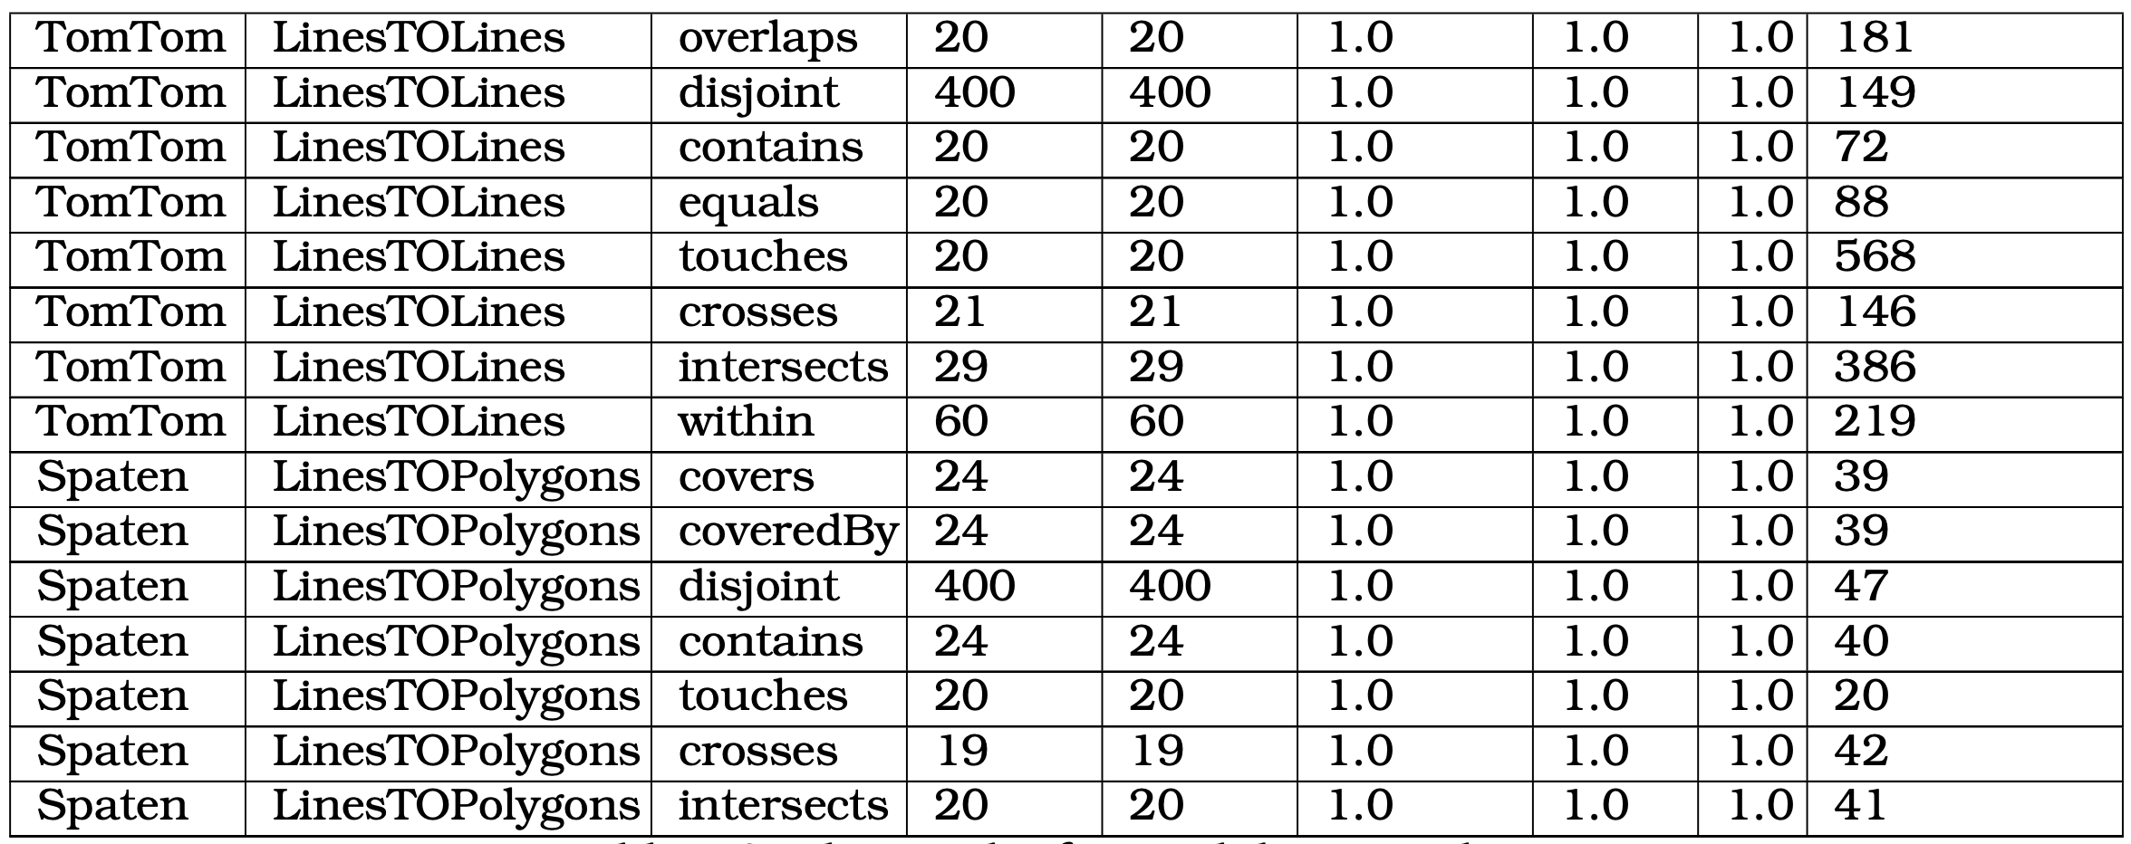
Result
Notes:
After checking the results, it is obvious that the spatial data were perfectly mapped to each other, and the running time was also fast. This shows that the algorithm performs very well when faced with data matching tasks with complete data formats.

Slide 37
Future Work

Slide 38
Resolving Problems in the SPIMBENCH
As mentioned in the previous chapter, the result shown that many algorithms achieved the same recall rate during the SPIMBENCH task, and I found it was because the field names in the target dataset did not match or there was no literal text data at all. So based on these two different problem scenarios, the possible solutions for the future work are the following ways:
Adding more fields to match;
Comparing the similarity of each field names;
Looking up each linking objects, and comparing their similarity;
Using NLP techniques etc.
Uploading Artifacts to The Maven Central Repository
LOOM-LD is an application using Maven as a build tool, so this application can upload the artifacts to the Maven Central Repository (MCR) to allow other developers to use it. Besides, it is also an open-source project on GitHub, more programmers who share the same interests in development can work together.
Deploying as A Service
Using Apache Jena to build an online service that allows other researchers to easily link ontologies with the standard SPARQL queries.
Implementing A SPARQL Generator
Unfortunately, for most people without a scientific background or industry experience, the general SPARQL syntax is still not cheap to learn, developing a tool that automatically creates or aids in the generation of SPARQL queries for linking ontologies by using these algorithms is quite necessary because these queries do not have to be written manually.

Slide 39

Thank you!
The source code of this project is open now: https://github.com/oeg-upm/loom-ld

Slide 40
References
[1] RDF. [Online]. Available: https://www.w3.org/RDF/
[2] Apache Jena – Getting started with Apache Jena. [Online]. Available: https://jena.
apache.org/getting_started/index.html
[3] An Introduction to RDF and the Jena RDF API. [Online]. Available: https://jena.apache. org/tutorials/rdf_api.html
[4] Jena Ontology API. [Online]. Available: https://jena.apache.org/documentation/ ontology/
[5] ARQ – A SPARQL Processor for Jena. [Online]. Available: https://jena.apache.org/ documentation/query/
[6] ARQ – Application API. [Online]. Available: https://jena.apache.org/documentation/ query/app_api.html
[7] ARQ – Writing Filter Functions. [Online]. Available: https://jena.apache.org/ documentation/query/writing_functions.html
[8] Reasoners and rule engines: Jena inference support. [Online]. Available: https://jena. apache.org/documentation/inference/
[9] Apache Jena Fuseki. [Online]. Available: https://jena.apache.org/documentation/ fuseki2/
[10] TDB. [Online]. Available: https://jena.apache.org/documentation/tdb/index.html
[11] Prasetya, D., Wibawa, A. & Hirashima, T. The performance of text similarity algorithms.
International Journal Of Advances In Intelligent Informatics. 4 (2018,5)
[12] Levenshtein, V. Binary Codes Capable of Correcting Deletions, Insertions and Reversals.
Soviet Physics Doklady. 10 pp. 707 (1966,2)
[13] Winkler, W. String Comparator Metrics and Enhanced Decision Rules in the Fellegi- Sunter Model of Record Linkage. Proceedings Of The Section On Survey Research Meth- ods. (1990,1)

Slide 41
References
[14] Jaro, M. Advances in Record-Linkage Methodology as Applied to Matching the 1985 Census of Tampa, Florida. Journal Of The American Statistical Association. 84, 414-420 (1989), https://www.tandfonline.com/doi/abs/10.1080/01621459.1989.10478785
[15] John W. Ratcliff and David E. Metzener, Pattern Matching: The Gestalt Approach. Dr. Dobb’s Journal. 46, (1988, 7)
[16] Murphy, A. The Finley Affair: A Signal Event in the History of Forecast Verification. Weather And Forecasting. 11, 3-20 (1996,3)
[17] Debatty, T., Implementation of various string similarity and distance algorithms. [online] GitHub. Available: https://github.com/tdebatty/java-string-similarity
[18] J.Herring (2011, May. 28). Simple Feature Access – Part 1: Common Architecture [Online]. Available: https://www.ogc.org/standards/sfa
[19] Clementini, E., Di Felice, P. & Oosterom, P. A small set of formal topological relationships
suitable for end-user interaction. Advances In Spatial Databases. pp. 277-295 (1993)
[20] LocationTech. JTS Topology Suite. [online] GitHub. Available: https://github.com/
locationtech/jts
[21] Ontology Alignment Evaluation Initiative. [online]. Available: http://oaei. ontologymatching.org/
[22] OAEI 2021 Instance Matching or Link Discovery. [online]. Available: https:// hobbit-project.github.io/OAEI_2021.html/
[23] Karlruhe. U, “Ontology Alignment Evaluation Initiative 1", (2005)
[24] Do. H, Melnik. S, & Rahm. E, “Comparison of Schema Matching Evaluations,” in Web,
Web-Services, And Database Systems, 2003, pp. 221-237

